Slide 1
بِسْمِ ٱللَّهِ ٱلرَّحْمَٰنِ ٱلرَّحِيمِ

Slide 2
Course: Web Designing
Institute: Corvit Systems Peshawar
Duration: 3-Month Web Designing & Development Course
1st class of web designing

Slide 3
Instructor: Muhammad Sahil
BS in Computer Science – University of Peshawar
1 Year MERN Stack Developer – E Digital Pakistan (KPITB)
1 Year Web Instructor – E Digital Pakistan
6 Months Web Instructor – University of Peshawar
Computer Science Teacher – Alflah Model College, Sarband
Experience with multiple local client projects
Full Stack / MERN Stack Web Developer | Web Instructor

Slide 4
What is Web Designing?
Web Designing is the process of creating the visual layout of websites.
Focuses on UI/UX, colors, typography & responsiveness.
Includes:
HTML (Structure)
CSS (Styling)
Basic JavaScript (Interactivity)

Slide 5
What is Web Development
Web Development is the functional side of websites.
Focuses on making websites work.
Includes:
HTML (Structure)
CSS (Styling)
Basic JavaScript (Interactivity)
Designing = How it looks
Development = How it works

Slide 6
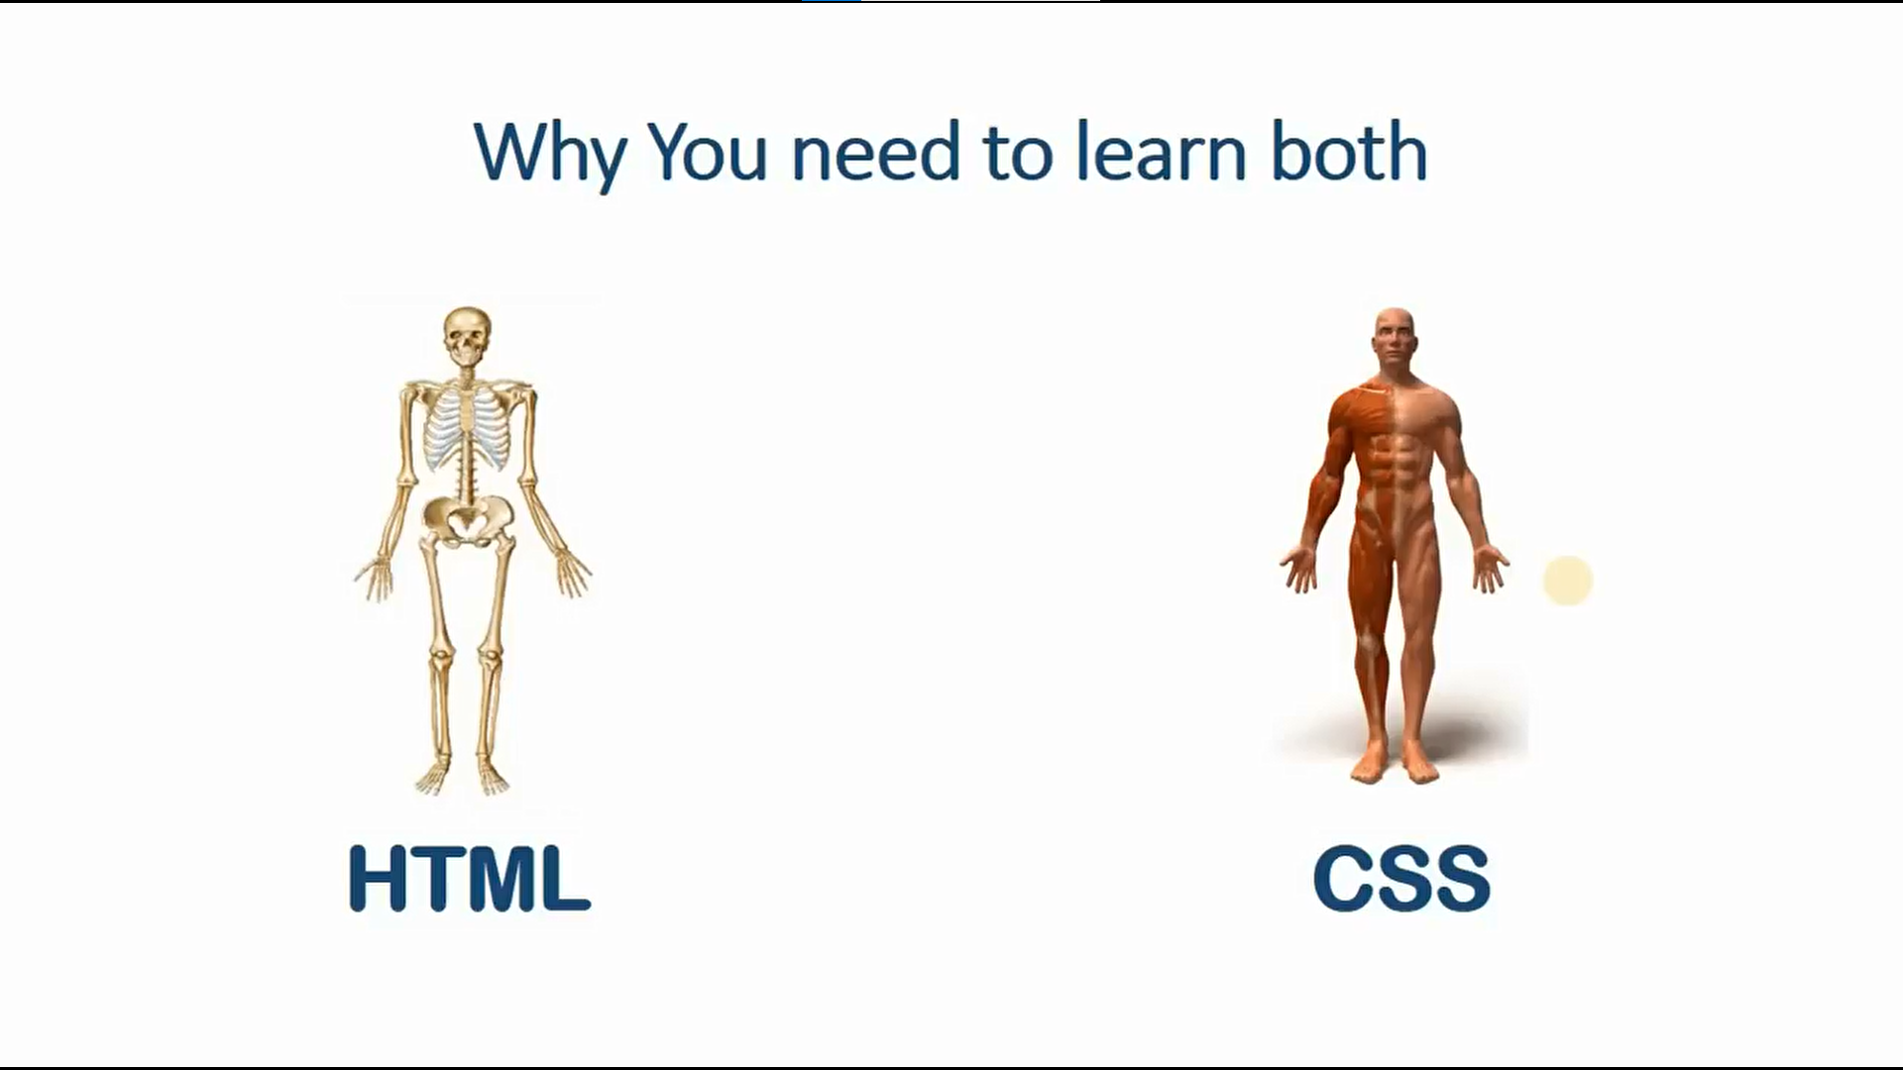

Slide 7
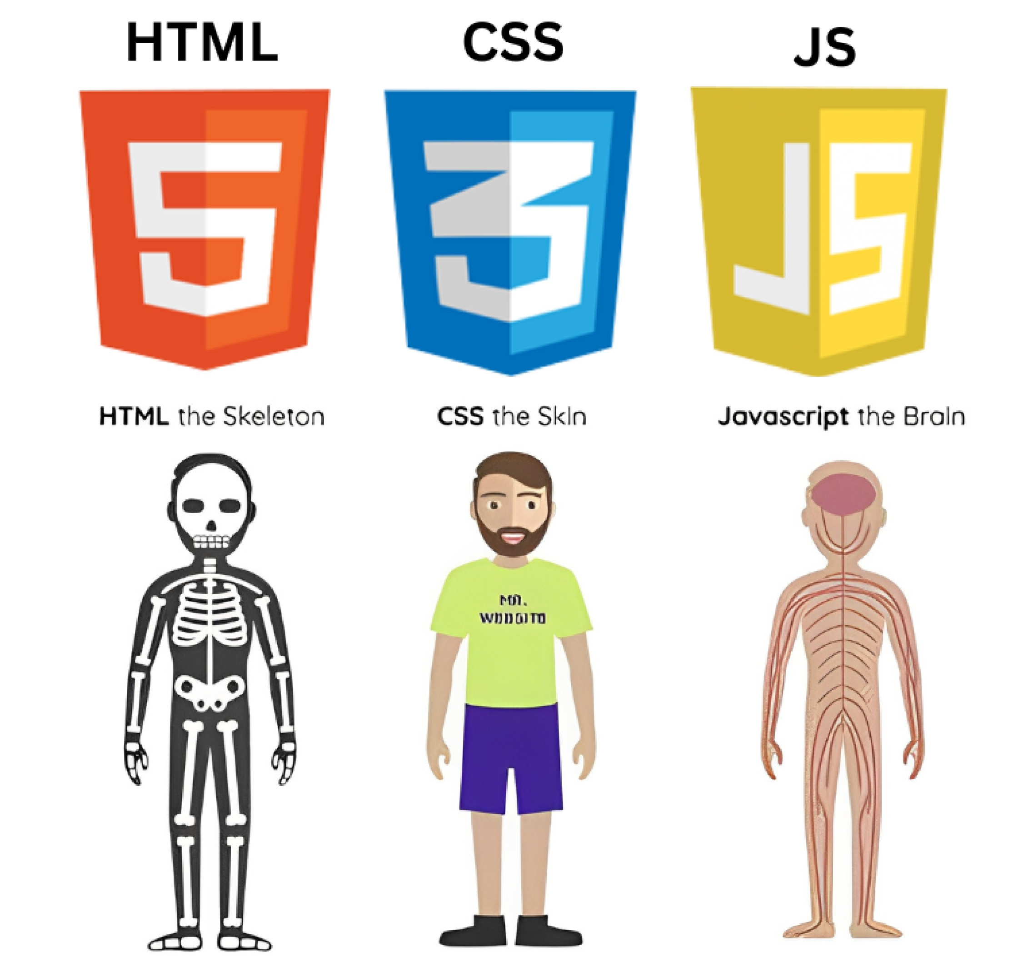
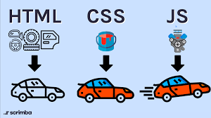
Importance of HTML, CSS, JavaScript

Slide 8
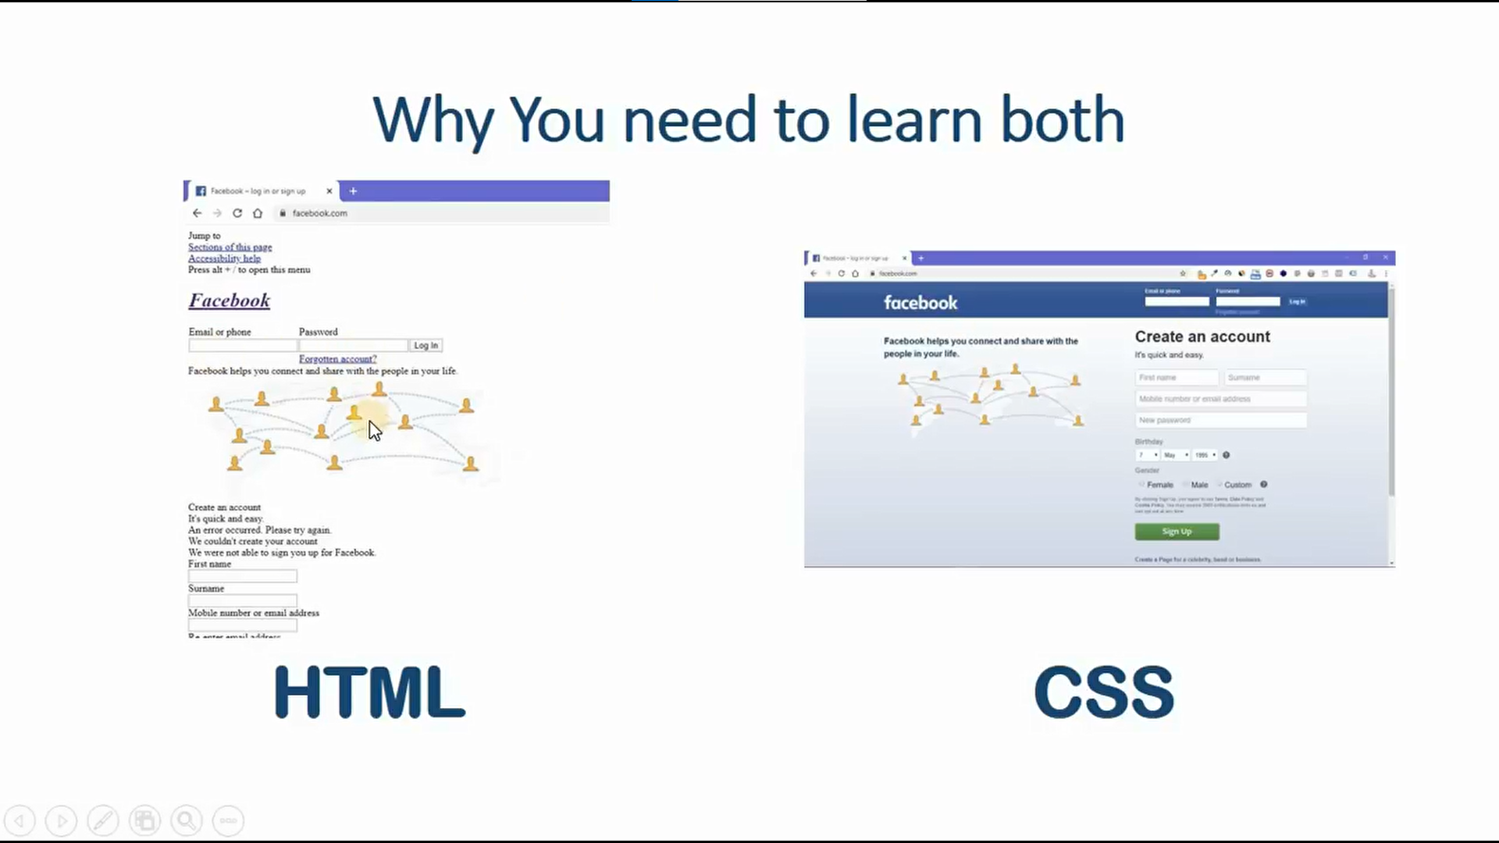
Without CSS how unbeautiful website looks

Slide 9
How Websites Work
Websites run through:
Client (Browser)
Server
Internet / Network
Steps:
User types a website URL
Browser sends HTTP request to server
Server processes request
Server sends back HTML, CSS, JS
Browser displays the webpage

Slide 10
What is HTML
HTML = HyperText Markup Language
It is the skeleton/structure of every website
Defines:
Headings
Paragraphs
Images
Links
Sections
Without HTML → No website structure

Slide 11
Why Do We Use HTML
To create webpage structure
Browsers understand HTML
Every website starts with HTML
Necessary for SEO & accessibility
Works with CSS & JavaScript

Slide 12
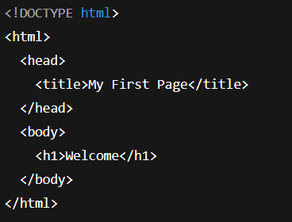
HTML Document Structure
<!DOCTYPE html> — Defines HTML5
<html> — Root element
<head> — Page info
<body> — Visible content

Slide 13
Creating Your First Webpage
Steps:
Open a folder/repository
Create a new file → index.html
Type basic HTML structure
Add <h1> heading
Save & open in browser

Slide 14
HTML Headings
HTML provides 6 levels of headings
<h1> → Main title <h1> Heading one </h1>
<h2> → Section title <h2> Heading two </h2>
<h3> → Sub-headings <h3> Heading three </h3>
<h4> → Sub-headings <h4> Heading four </h4>
<h5> → Sub-headings <h5>Heading five </h5>
<h6> → Sub-headings <H6>Heading six </h6>

Slide 15
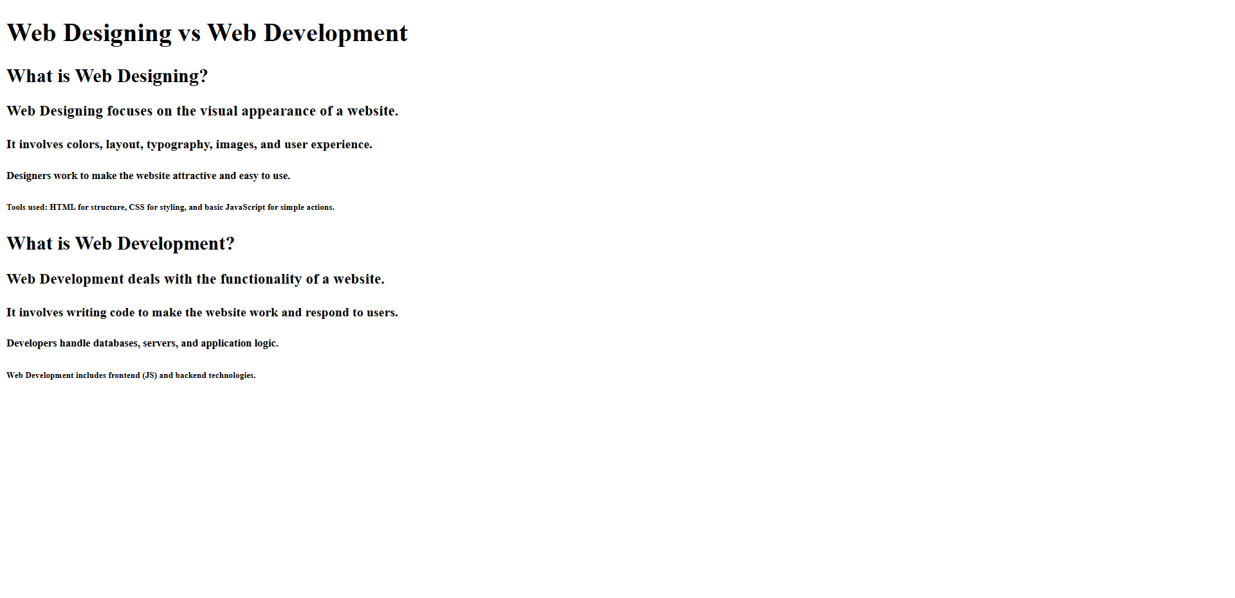
Assigment for next class

Slide 16
Summary
Today you learned
Web Designing vs Web Development
How websites work
What HTML is
HTML structure
How to create your first webpage
HTML Headings
Next Class → HTML Basic Tags & Formatting

